Slide 1
Easter in France

Slide 2
What is the French for Shrove Tuesday?
Mardi Gras
Pâques
Crêpes

Slide 3
a. Mardi Gras. It means fat tuesday

Slide 4
What happens on Shrove Tuesday in France?
Children have fancy dress competitions
There is no school
People eat a special type of bread

Slide 5
a. Fancy dress competitions and parades

Slide 6

What is the French for Easter?
Easter
Pâques
Chocolate

Slide 7
b. Pâques

Slide 8
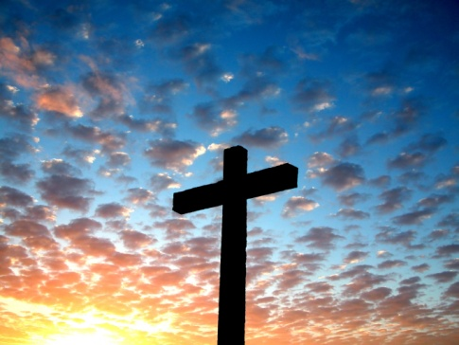
What is the main religion in France?
Catholic
Anglican
Muslim

Slide 9
a. Catholic

Slide 10
Who is Head of the Catholic Church?
The Queen
There isn’t one
The Pope

Slide 11
c. The Pope. He lives in the Vatican, in Italy.

Slide 12
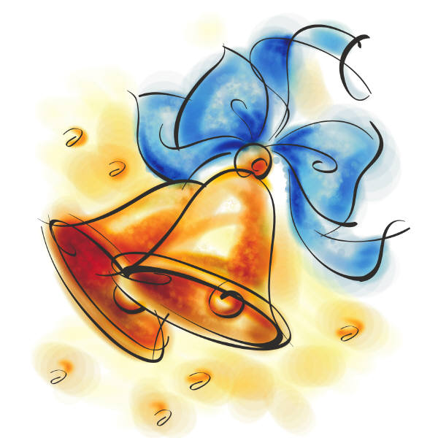
What happens to the Church bells on the Thursday before Easter?
They stop ringing
They ring all day
They ring every hour

Slide 13
a. They stop ringing. Supposedly gone to see the Pope.

Slide 14

How many days does the Easter bank holiday weekend last?
Two days as normal
Four days as in England
Three days – Saturday Sunday and Monday

Slide 15
c. 3 days. People work and go to school on Good Friday

Slide 16
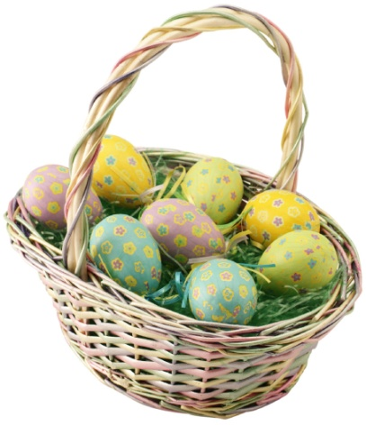
What do pupils in Church schools do at 3pm on Good Friday?
Have a minute silence
Have an Easter egg hunt
Do a special Easter quiz

Slide 17
a. Have a minute silence. It is the time Jesus died.

Slide 18
Who delivers presents to children on Easter Sunday?
The Easter bunny
The Church bells
The Easter chick

Slide 19
b. The Church bells. On their way back from Rome

Slide 20
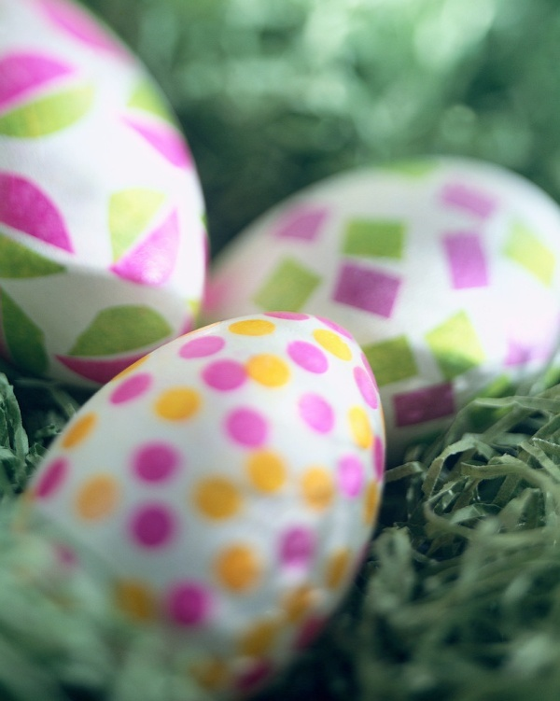
What sort of presents do children receive?
Chocolate eggs and bells
Bell shaped bread and biscuits
Toys

Slide 21
a. Chocolate eggs and bells

Slide 22
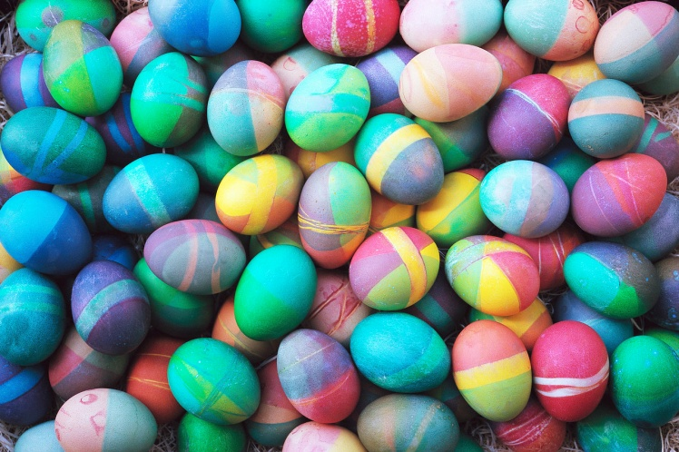
What happens on 1st April?
There is no school
It’s a play only day at school
Children have to stick a paper fish on adults’ backs

Slide 23
c. Children cut out fish shapes and stick them on the back of adults

Slide 24
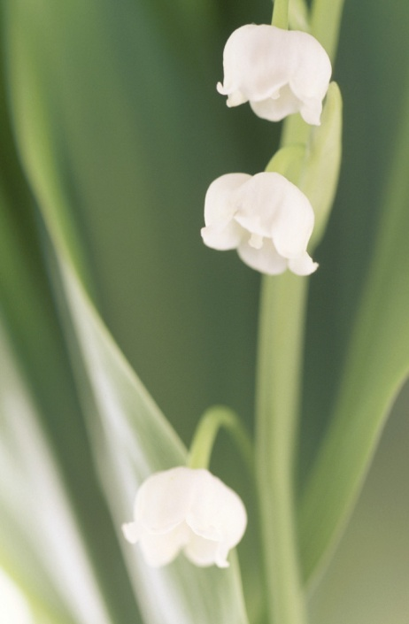
What happens on 1st May?
It’s a bank holiday
People give lily of the valley for good luck
It is the first of 3 bank holidays in May

Slide 25
All three of them!

Slide 26
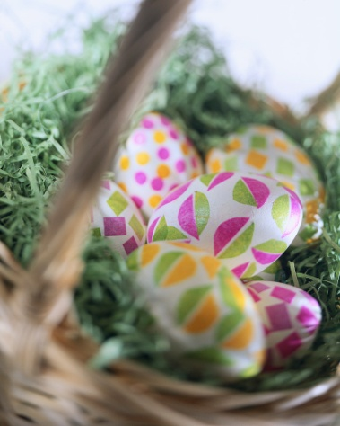
What does “Joyeuses Pâques” mean?

